Slide 1
How to add visualisation to Toolbar
Currently only available in Grand Union.

Slide 2
How to add visualisation to tool bar
This may not be possible depending on organisation settings, if this doesn’t work you will need to speak to someone in your practice.
Start by logging into S1
Right click on small tool bar and select configure toolbar
(You are only allowed a max 30 icons on here so this won’t work if you have already maxed this out!)
Double click on any of the small toolbars
In search type ‘visuali…’

Slide 3
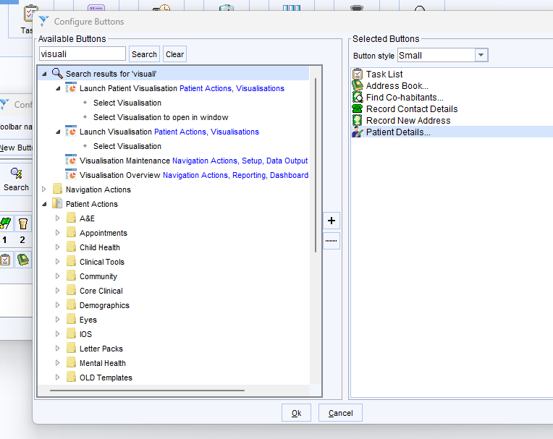
IMPORTANT: ensure you select the option to select ‘visualisation to open in window’

Slide 4
Continued…
Double click to open list of visualisations and
Select Chronic Kidney Disease Review
Click Ok
Select OK again
Select Ok a final time
You should then have a little kidney icon on the small tool bar you clicked on at the start.
You will need a patient open to be able to utilise this so until then it will be grey’d out.

Slide 5
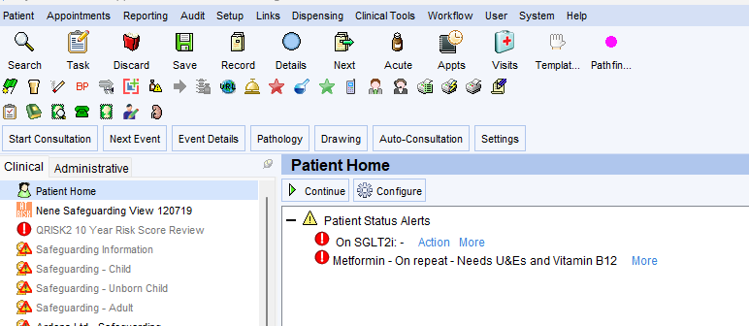

Slide 6
To Use
Will only work when you are in a patient record.
Click the icon on the toolbar to open
If installed as above, you will have full interaction with other S1 templates/ICE etc whilst the visualisation is open.
Several parts of the visualisation are collapsable menus so can be opened out or closed as required.
NB Exception codes are mapped to reporting so please use these where possible.
Any feedback or queries please email:
Philippa.jones10@nhs.net

