Slide 1




Chronic Kidney Disease: Why it matters and helping patients
Matthew Graham-Brown
Clinical Associate Professor of Renal Medicine

Slide 2
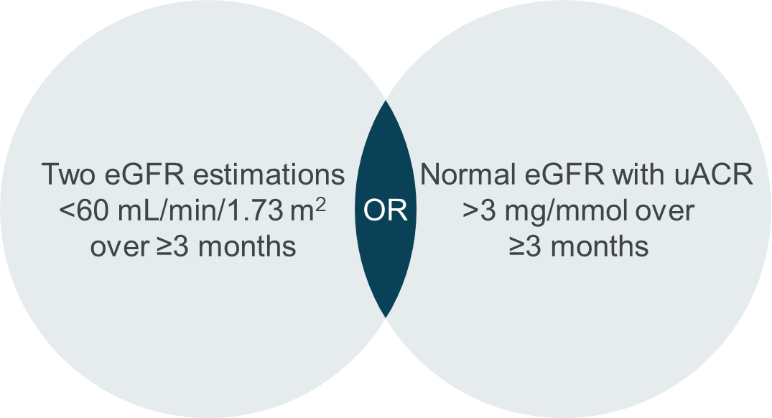
Chronic Kidney Disease
"a persistent abnormality in kidney structure or function"

Slide 3
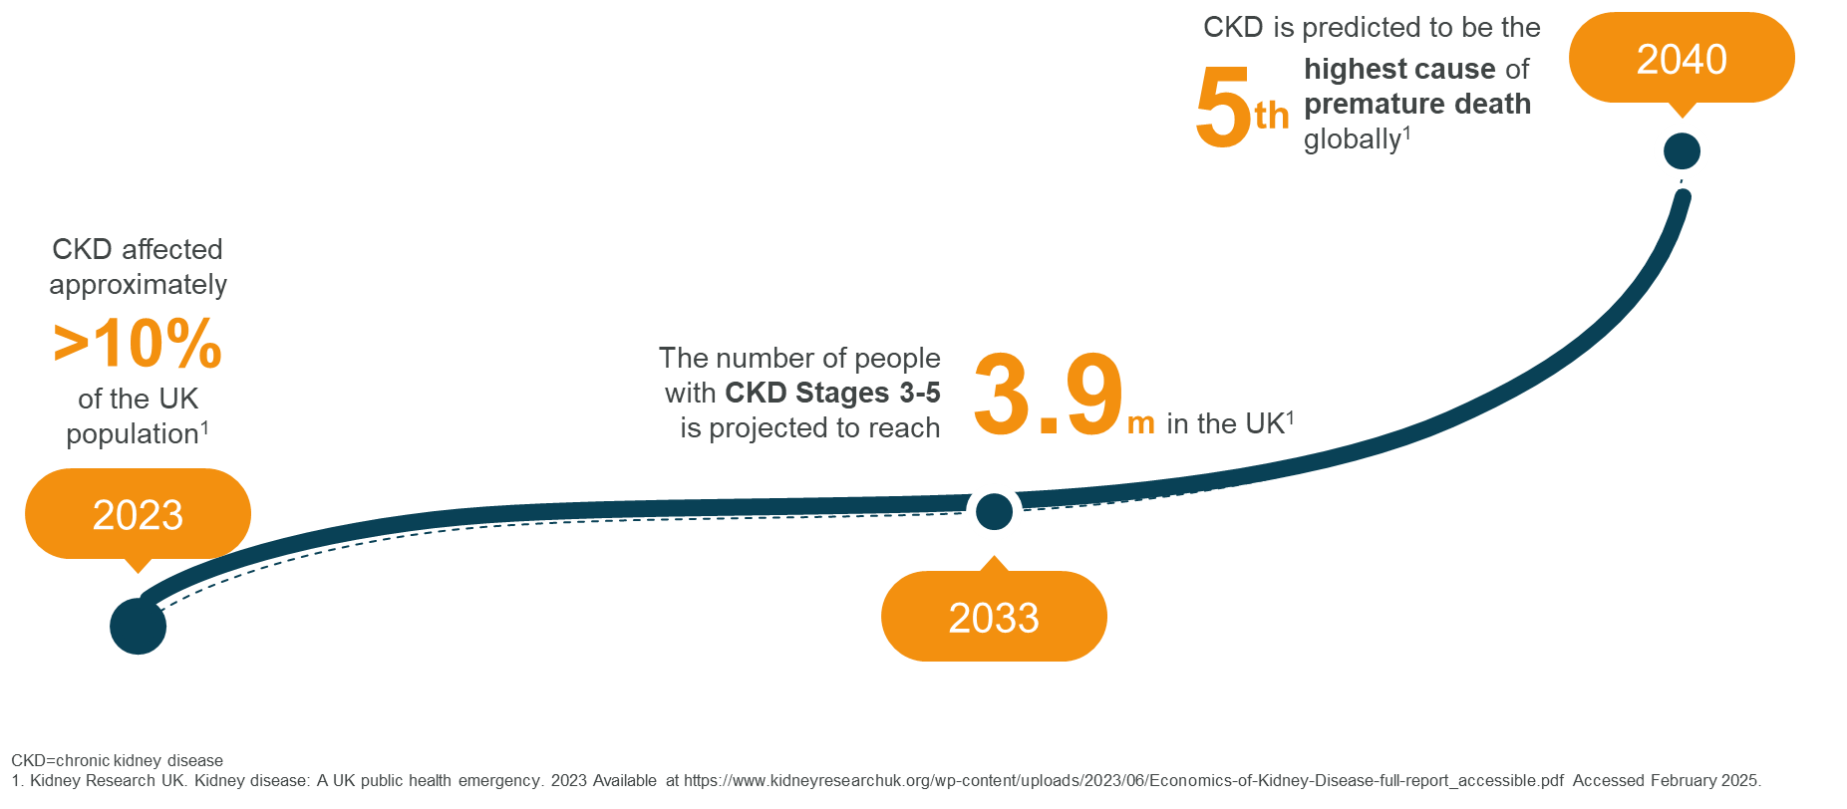
The increasing risk of CKD

Slide 4
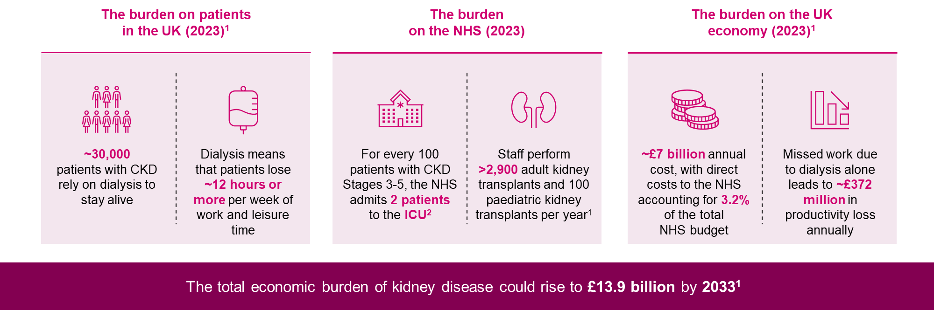
The burden of CKD on patients, the NHS and the economy

Slide 5
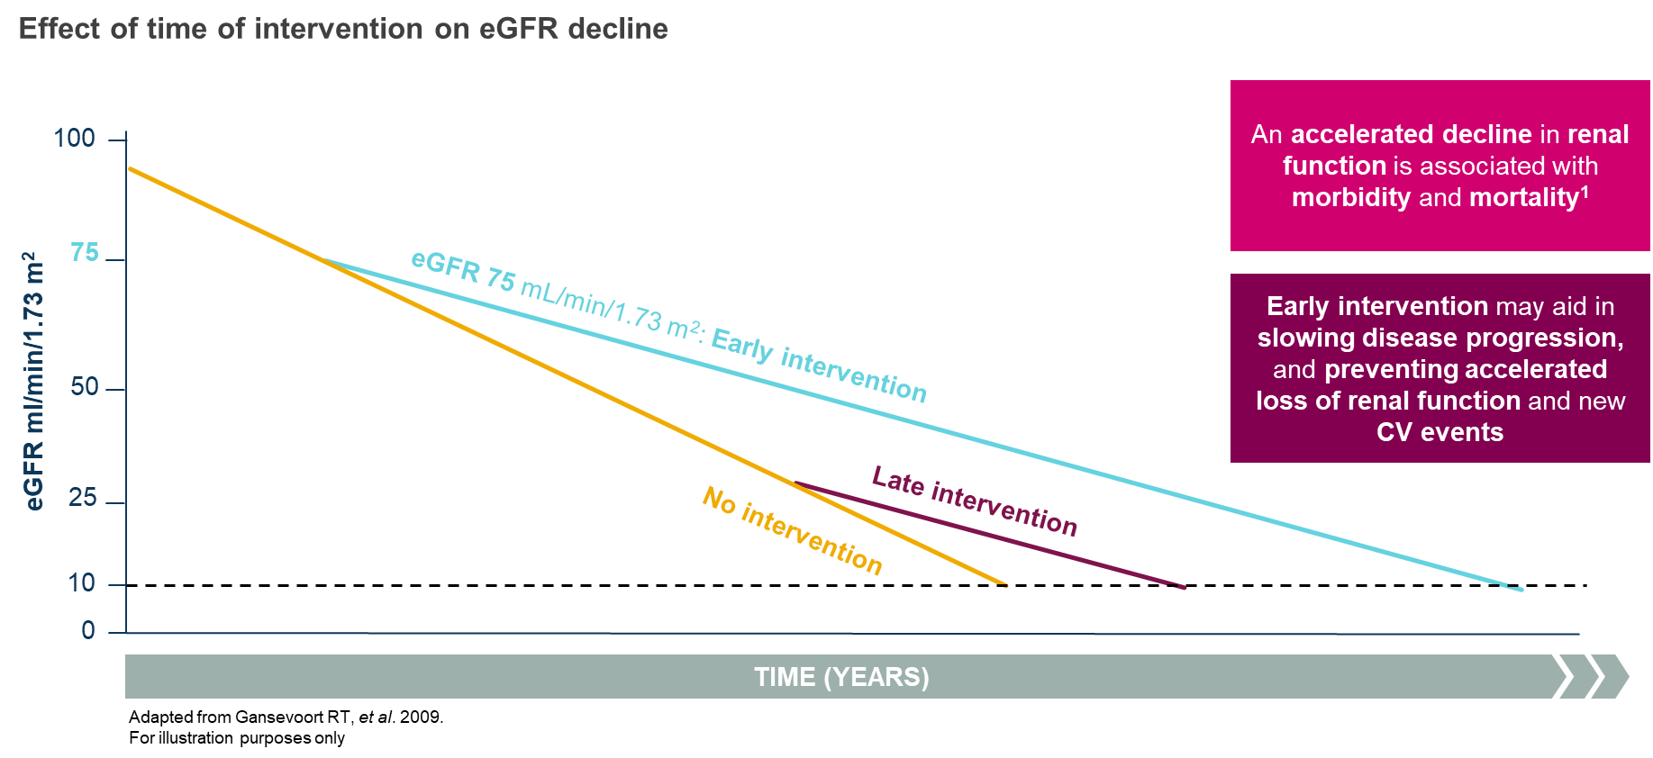
Early intervention

Slide 6




10 Year Health Plan: 3 Strategic Shifts

Slide 7



CKD in primary care: Reality
Diagnosed and managed in primary care – infrequent or no input from kidney specialists
Patient awareness of CKD and their knowledge is low [2-4]
Many are unaware of their diagnosis or the effect of poor control on their health [5]
Infrequent and limited discussions between HCPs and patients [6]
Support and education through face-to-face interactions in clinical setting is minimal [2,7]
[1] Kidney Care UK, 2023 [2] Jankowski et al., 2021. Circulation [3] Welch et al., 2016. Nephrol Nurs J [4] Molnar et al., 2020. CJKHD [5] Finkelstein et al., 2008. KI [6] Greer et al., 2012. JRC [6] Greer et al., 2011. Am J Kidney Dis [7] Donald et al., 2018. BMJ
Notes:
Previous systematic reviews³⁵⁻³⁸ and integrative reviews⁵ ¹⁹ ²⁰ of self-management interventions in CKD patients have shown improvements in self-care activities. However, they are variable in their effectiveness for managing and preventing progression of CKD. A recent review highlighted a wide range of self-management interventions for adults with CKD with considerable heterogeneity in outcomes⁴. The wide variations in the content, delivery and components of digital self-management interventions (e.g., self-monitoring and education), alongside outcomes assessed and results obtained, make it difficult to compare findings across studies evaluating self-management programmes³⁹. Consequently, there is a paucity of knowledge about which components of these programmes are most effective⁴⁰.
Despite the importance of theory-driven interventions⁴¹, efforts to improve CKD self-management have been largely atheoretical²⁰. Major gaps in the literature include lack of patient engagement in intervention design (an estimated <1% of programmes are co-developed with patients), and failure to apply behaviour change theory (only 20% are based on a theory or framework)⁴. Person centeredness, applicability to comorbidities associated with CKD, and physiological and non-physiological outcomes are also often lacking from self-management interventions⁴.
Meaningful information relating to the patient perspective of self-management interventions is lacking from the literature but is key to providing valuable information regarding attitudes towards and challenges associated with self-management and self-management interventions⁵. Further, patients have highlighted that interventions need to be individualised and tailored to their specific situations and preferences (e.g., awareness of having CKD, stage of CKD, knowledge of the disease, access to resources, etc.)⁴. Engaging patients by involving them in the co-design of such interventions will ensure their values, culture and psychosocial needs are addressed in the intervention⁵ ¹⁹ ²⁰.

Slide 8
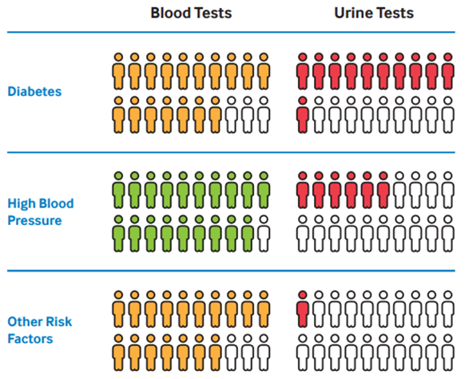
National CKD Audit – Annual eGFR & ACR
CKD National Audit: ckd_audit_report.pdf(lshtm.ac.uk)

Slide 9
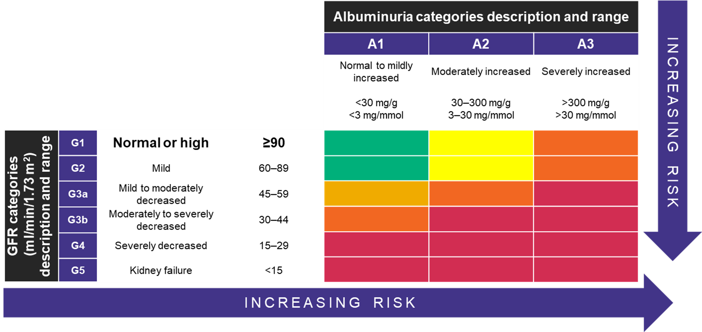
N.B. eGFR≥60 requires another criteria to be classified as CKD.
Recommendations | Chronic kidney disease: assessment and management | Guidance | NICE

Slide 10

The Kidney Failure Risk Equation
The 4-variable KFRE is calculated from:
  Age in years
  Sex
  Estimated glomerular filtration rate (CKD-EPI eGFR)
  Urine albumin creatinine ratio (ACR)
  Refer to secondary care if risk of ESKD >5% at 5 years
1. www.kfre.co.uk​​ 2. KFRE UKKA 03.22.pdf (ukkidney.org)​
3. Recommendations | Chronic kidney disease: assessment and management | Guidance | NICE

Slide 11
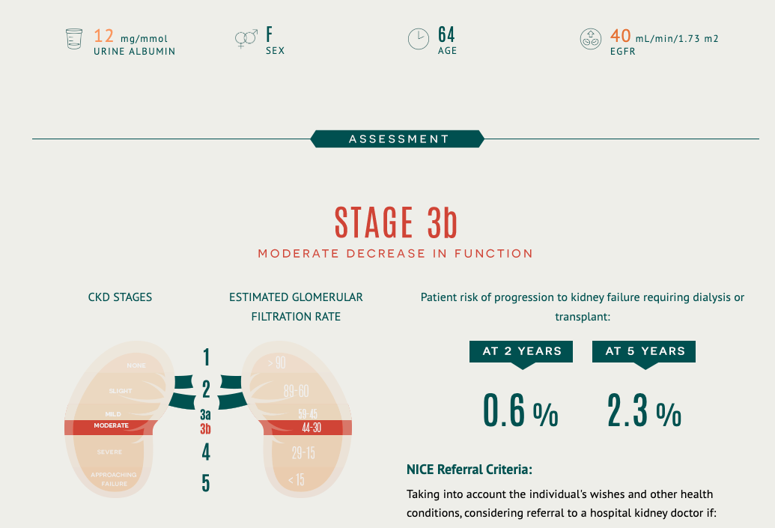
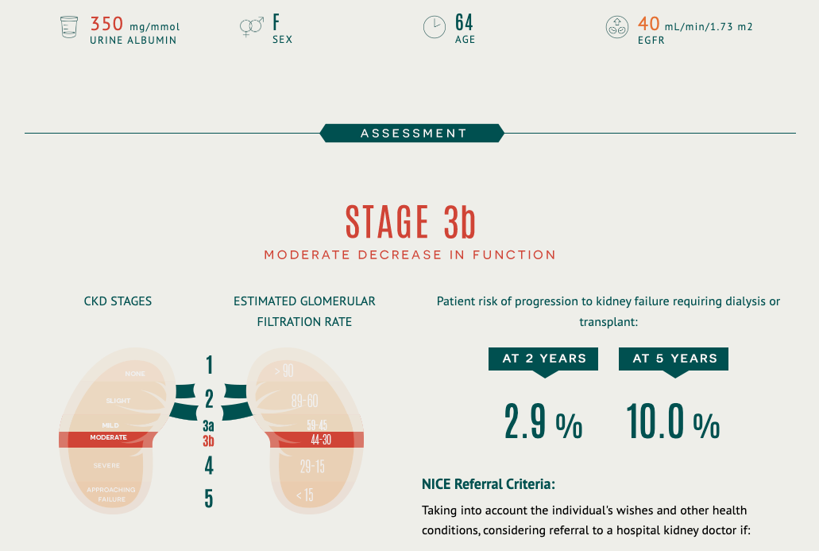
4-variable KFRE

Slide 12
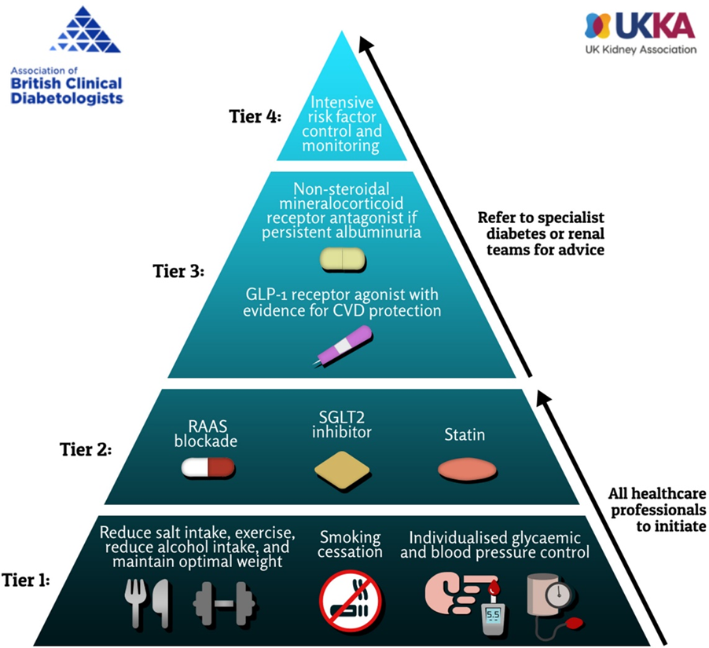
A tiered approach to CKD management
Taken from Dasgupta I, et al. Diabet Med. 2024:e15450.

Slide 13

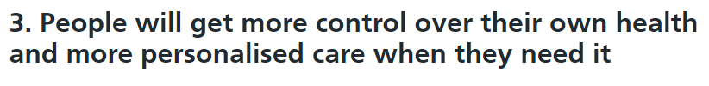
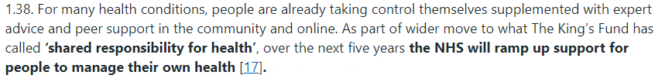
'Patient Education' (vs Self Management)
'the process of receiving or giving systematic instruction'
Education enhances knowledge
Knowledge alone does not result in action
Action is required to affect behaviour
NHS Long Term Plan's commitment to personalised care [2,3]

Slide 14

'Self-management'
Essential component in chronic disease management [1]
For health optimisation, appropriate disease and healthcare management are key behaviours [2]
Knowledge
Patient activation
Self-management
Skills
Confidence
[1] Wagner, 1998. Eff. Clin. Pract. [2] Hibbard et al., 2007. Health Serv.
Notes:
The Chronic Care Model has identified Self-management is an essential component in chronic disease management to empower patients to take a more active role their health [4]. There is no universally accepted definition of self-management; however, many definitions include the maintenance of wellness and the management of chronic conditions [5], whereby an individual takes responsibility for all, or some, aspects of the day-to-day management of their condition [6].
Complex set of processes and tasks that involves [1]:
utilising an individuals’ knowledge (education), skills, and confidence to manage their disease
being able to identify and access resources and support
learning to cope and live with the condition, including the impact upon an individuals’ life and the emotional consequences
Appropriate disease and healthcare management are key behaviours for health optimisation in people with long-term conditions including CKD. Effective self-management of health requires appropriate knowledge, skills and confidence.
The goal of self-management is to identify strategies that can be used to help patients manage their condition(s) whilst leading full, active, and productive lives. For those with CKD, self-management behaviours range from medication adherence, health and symptom monitoring, and lifestyle modifications (e.g. increasing physical activity and eating an appropriate diet) which reduce cardiovascular, CKD, and general health risk factors\
Previous systematic reviews³⁵⁻³⁸ and integrative reviews⁵ ¹⁹ ²⁰ of self-management interventions in CKD patients have shown improvements in self-care activities. However, they are variable in their effectiveness for managing and preventing progression of CKD. A recent review highlighted a wide range of self-management interventions for adults with CKD with considerable heterogeneity in outcomes⁴. The wide variations in the content, delivery and components of digital self-management interventions (e.g., self-monitoring and education), alongside outcomes assessed and results obtained, make it difficult to compare findings across studies evaluating self-management programmes³⁹. Consequently, there is a paucity of knowledge about which components of these programmes are most effective⁴⁰.
Despite the importance of theory-driven interventions⁴¹, efforts to improve CKD self-management have been largely atheoretical²⁰. Major gaps in the literature include lack of patient engagement in intervention design (an estimated <1% of programmes are co-developed with patients), and failure to apply behaviour change theory (only 20% are based on a theory or framework)⁴. Person centeredness, applicability to comorbidities associated with CKD, and physiological and non-physiological outcomes are also often lacking from self-management interventions⁴.
Meaningful information relating to the patient perspective of self-management interventions is lacking from the literature but is key to providing valuable information regarding attitudes towards and challenges associated with self-management and self-management interventions⁵. Further, patients have highlighted that interventions need to be individualised and tailored to their specific situations and preferences (e.g., awareness of having CKD, stage of CKD, knowledge of the disease, access to resources, etc.)⁴. Engaging patients by involving them in the co-design of such interventions will ensure their values, culture and psychosocial needs are addressed in the intervention⁵ ¹⁹ ²⁰.

Slide 15










My Kidneys & Me (MK&M)
A theory- and evidence-based structured self-management programme for people living with non-dialysis CKD [1]
Co-developed with people with CKD, their relatives, CKD multidisciplinary team, digital health experts
Leads to:
Increase patient activation
Reduce health risks
Improved symptom management
Increase physical function
Designed to improve self-management behaviours
  Improve knowledge
  Promote self-care skills
  Improve investigation and medication adherence
  Improve well-being
  Increase physical activity
[1] Lightfoot et al., 2022. JMIR
Notes:
We have developed a theory and evidence based digital self-management programme for people living with non-dialysis CKD, which includes structured 10-week education, called My Kidneys & Me
The aim of My Kidneys & Me is to improve and maintain self-management behaviours, by increasing knowledge, promoting self-care skills, increasing self-efficacy, improving well-being, and improving lifestyle behaviours including increasing physical activity
The programme goal is to improve the knowledge, skills, and confidence of people with CKD in managing their health, and consequent self-management behaviours
The key outcomes are to increase patient activation, the knowledge, skills and confidence an individual has in managing their health and healthcare, reduce health risks including cardiovascular risks, manage symptoms and well-being, and increase physical function

Slide 16

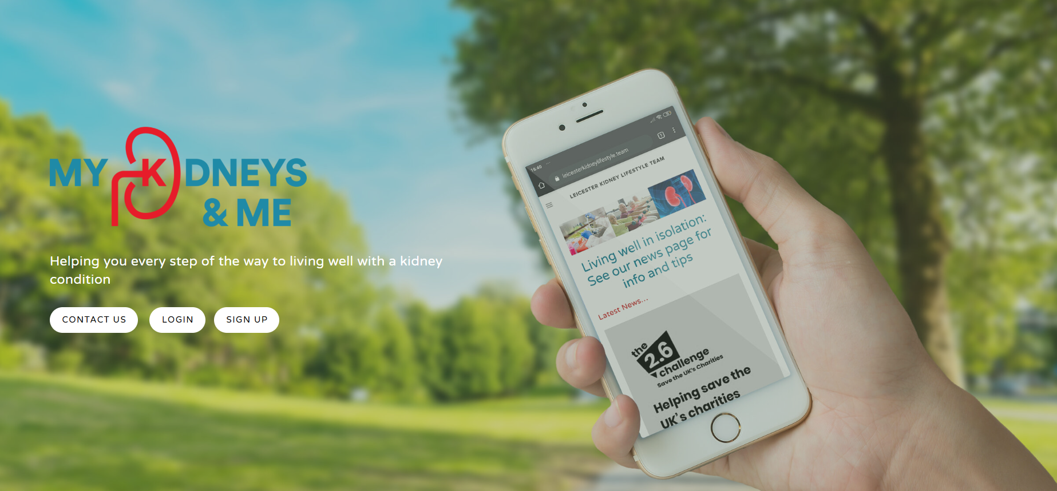
In person staff and patient sessions
Supporting Digital Health platform

Slide 17
In person sessions
Importance and relevance of CKD
Why self-management matters
Reinforcing most treatments and recommendations for CKD are the same as for other chronic disease (diabetes, cardiovascular disease)
How to use the digital platform
Time and support for patients to learn how to get onto the platform and to access the resources
The strategies that practices can use to maximise uptake

Slide 18
Implementation strategy – Annual cycle
Initial in person/online session for staff
Setting a date for the in person (or virtual) session for patients
Text messaging to patients with CKD inviting to the in person education session (can include immediate link to digital platform), 2 & 4 weeks prior to in person event. Plus in practice advertising
In person patient (and staff) education session with support for patients to access the program
In practice flyers and posters. Staff distribution. Scheduled reminder text messaging

Slide 19
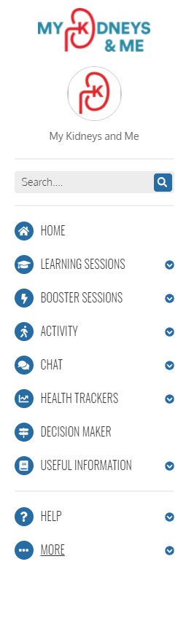
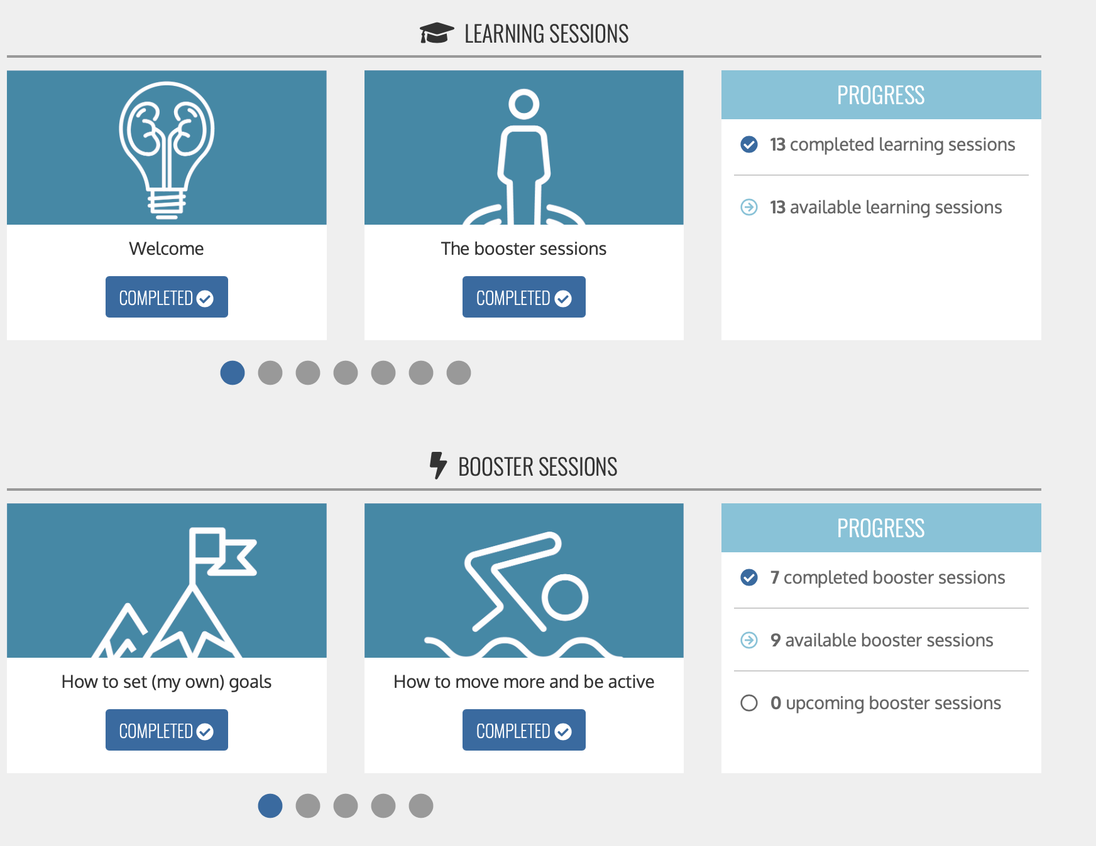
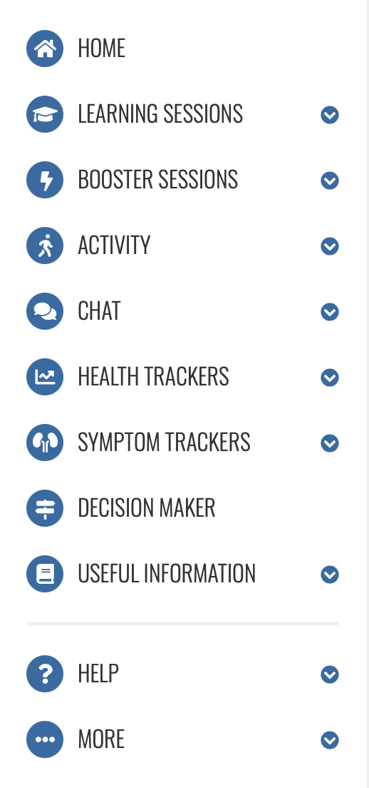
Notes:
Based on patient input and needs, MK&M was designed to comprise educational (Learn about …) and behaviour change (How to …) sessions, health trackers (e.g. blood pressure, weight, fruit and veg consumption), symptom tracker, exercise trackers, goal setting features, and social support. For example, to improve symptom management behaviours, patients can use MK&M to: 1) learn about symptoms associated with CKD and strategies to help manage these symptoms; 2) learn how to recognise and keep track of their symptoms so that they can modify their lifestyle accordingly and speak to their healthcare professional if needed; 3) track their symptoms using a bespoke tool.

Slide 20
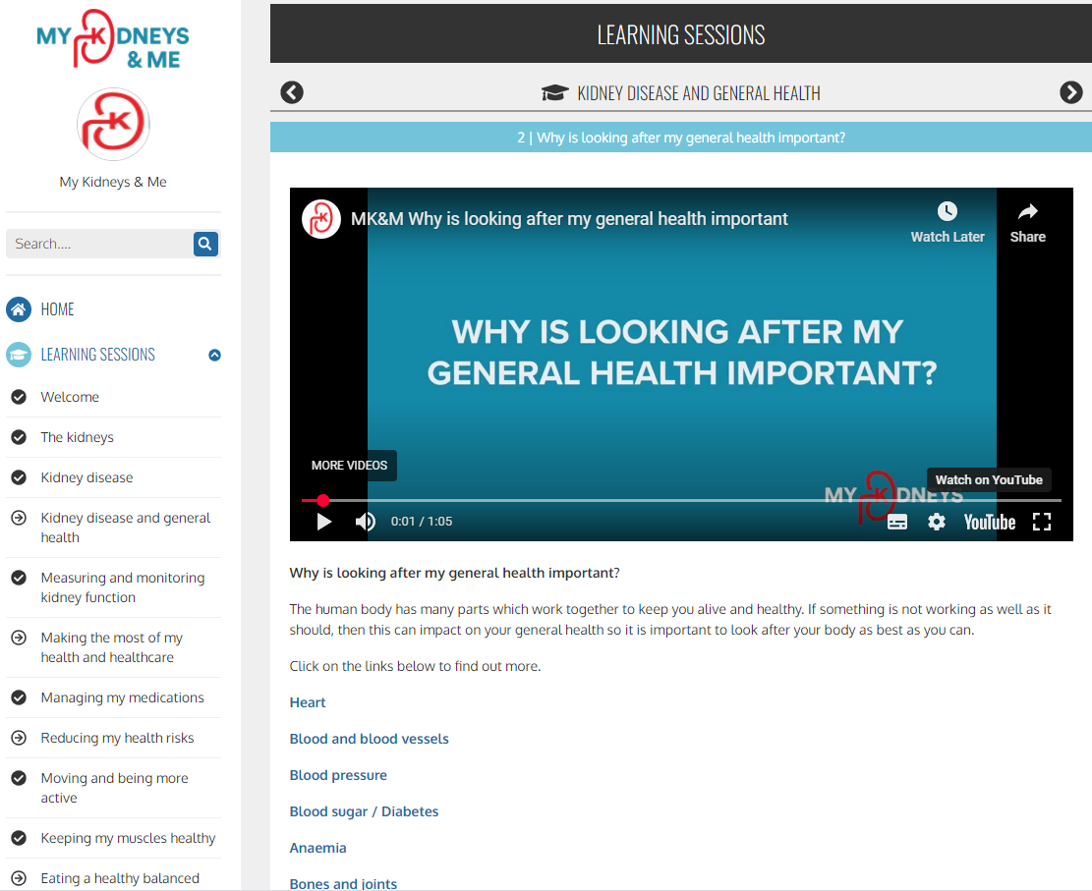
Educational sessions

Slide 21
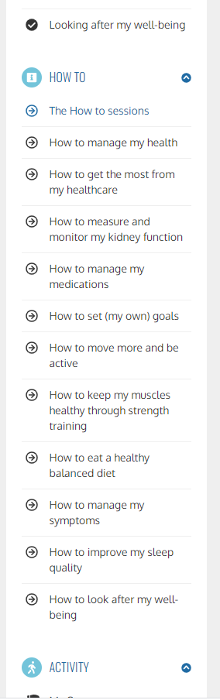
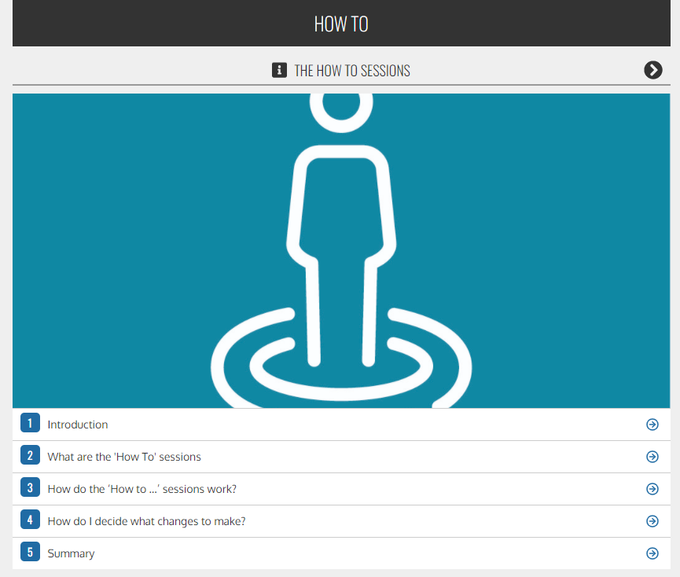
‘How to’ sessions
(knowledge to action)

Slide 22
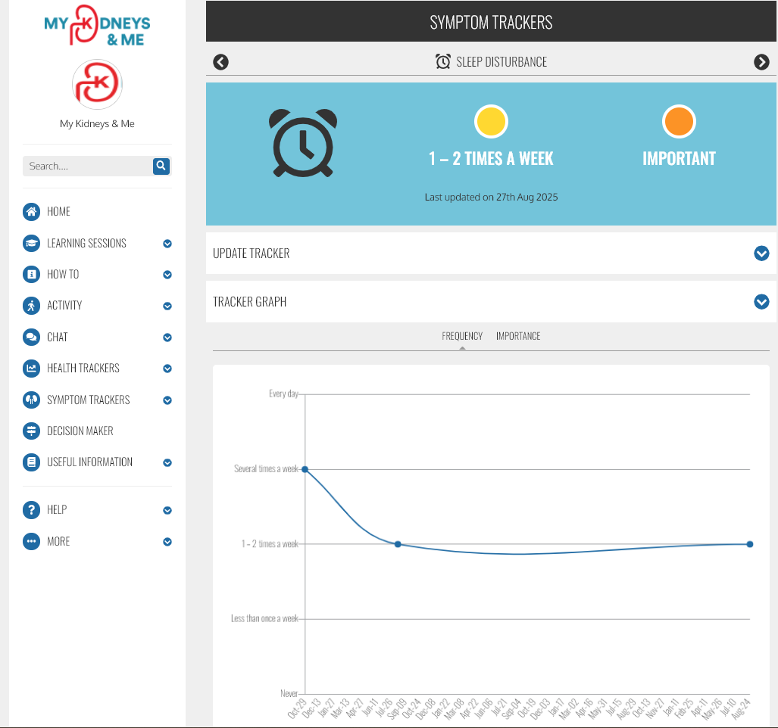
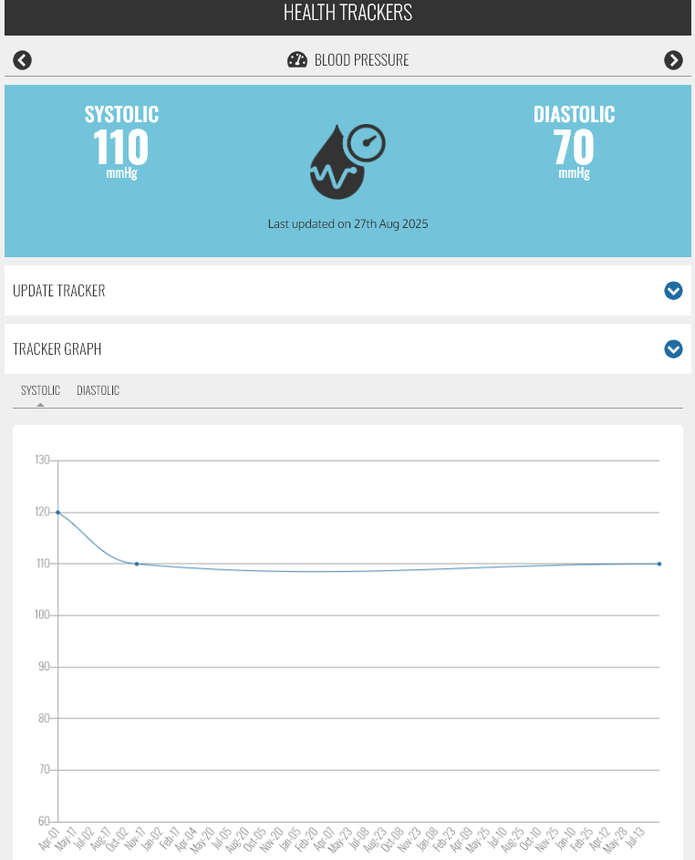
Symptom & Health trackers

Slide 23
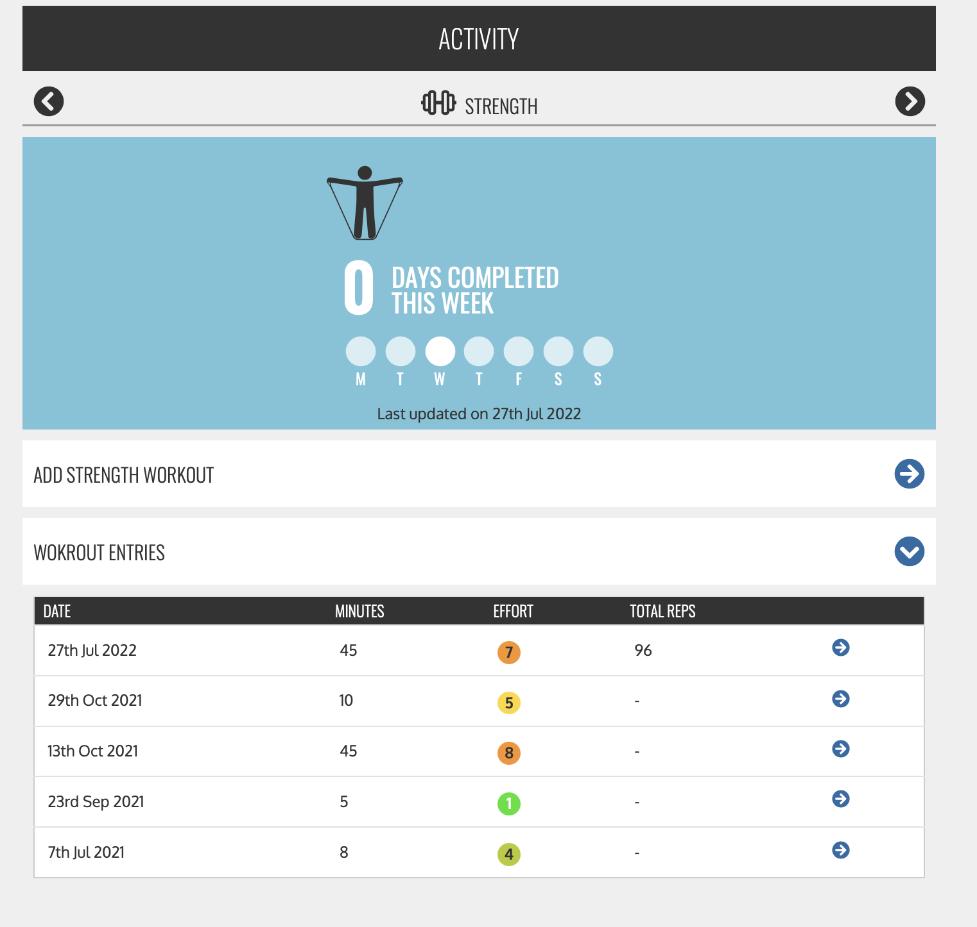
Activity trackers

Slide 24
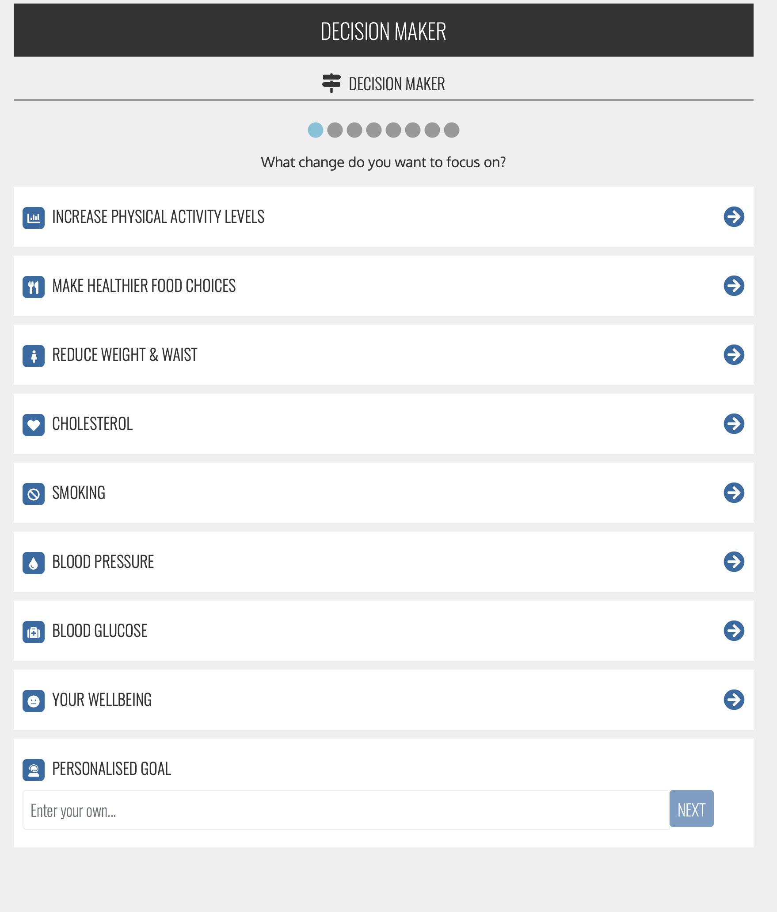
Decision support tools

Slide 25
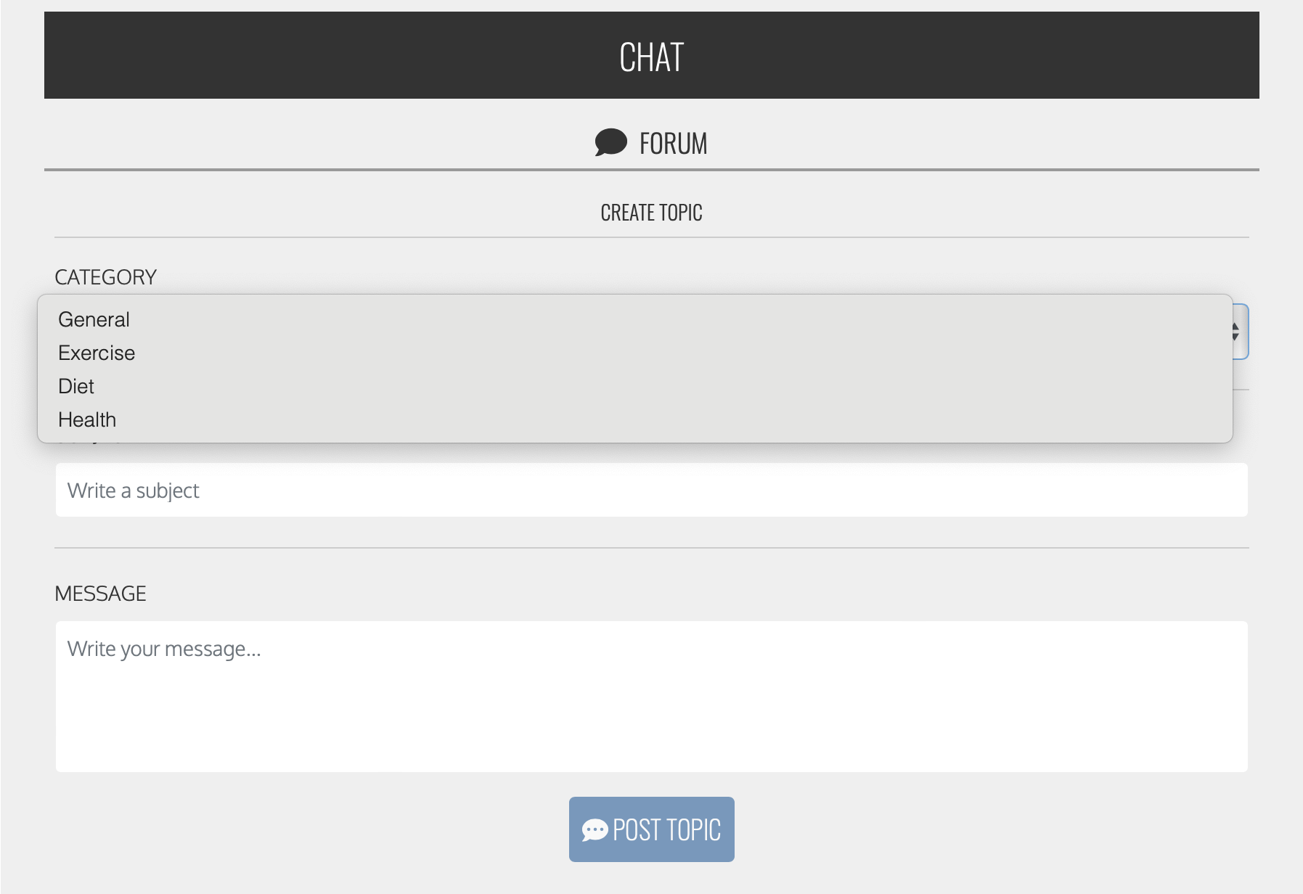
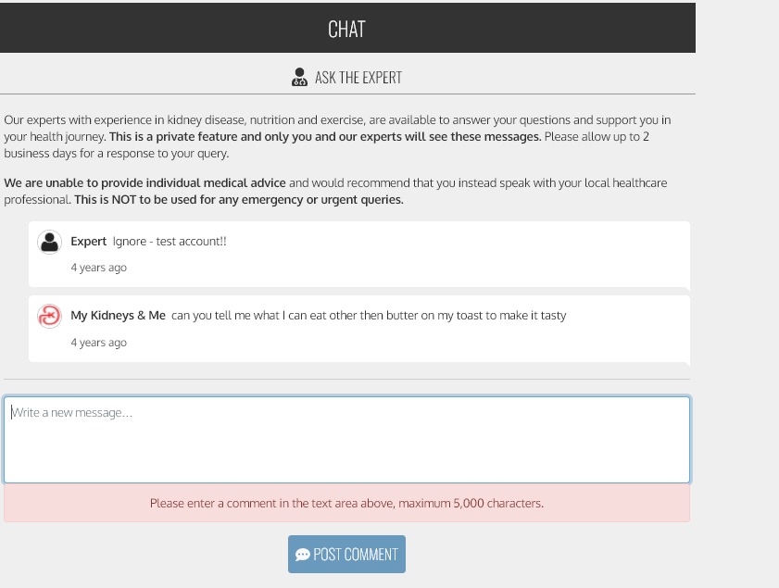
Chat forums
Ask the expert
Peer-peer

Slide 26
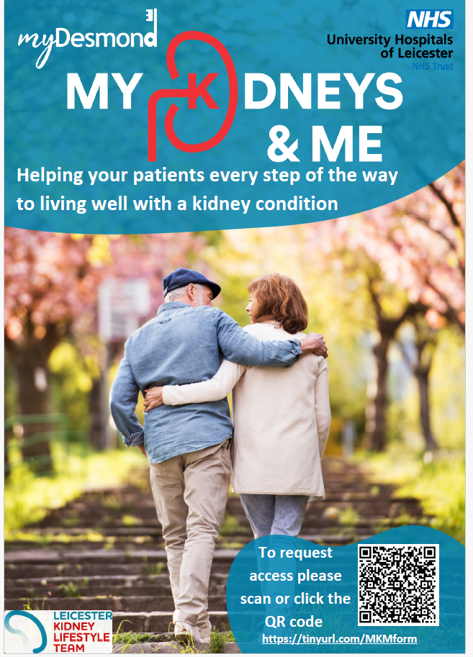
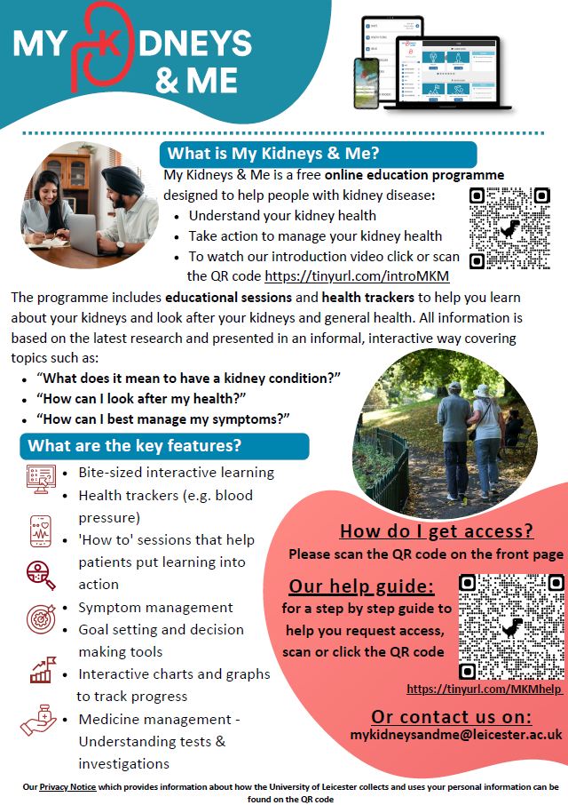

Slide 27



Slide 29
My Kidneys & Me – Learning to look after your health and your kidneys
Matthew Graham-Brown
Clinical Associate Professor of Renal Medicine

Slide 30
Your kidneys
Most people have 2 kidneys
Filter the blood and make wee
Control amount of salt and water in your body
Control your blood pressure
Help make blood cells that carry oxygen
Help keep your bones healthy

Slide 31
'Chronic' kidney disease
When you have kidney disease
High blood pressure
Anaemia (low blood counts)
High risk of heart disease
High risk of bone disease
Risk of swelling up with fluid
Risk of kidney failure

Slide 32
Getting tested
Blood tests (kidney function)
Urine test (protein in the urine)
Kidney failure risk (calculated from the above and done by staff)

Slide 33
Getting treated
Treatments for blood pressure
Treatments for diabetes
Treatments for heart disease
Special treatments for kidney disease
Having a healthy diet
Having a healthy lifestyle, including being physically active and taking exercise

Slide 34


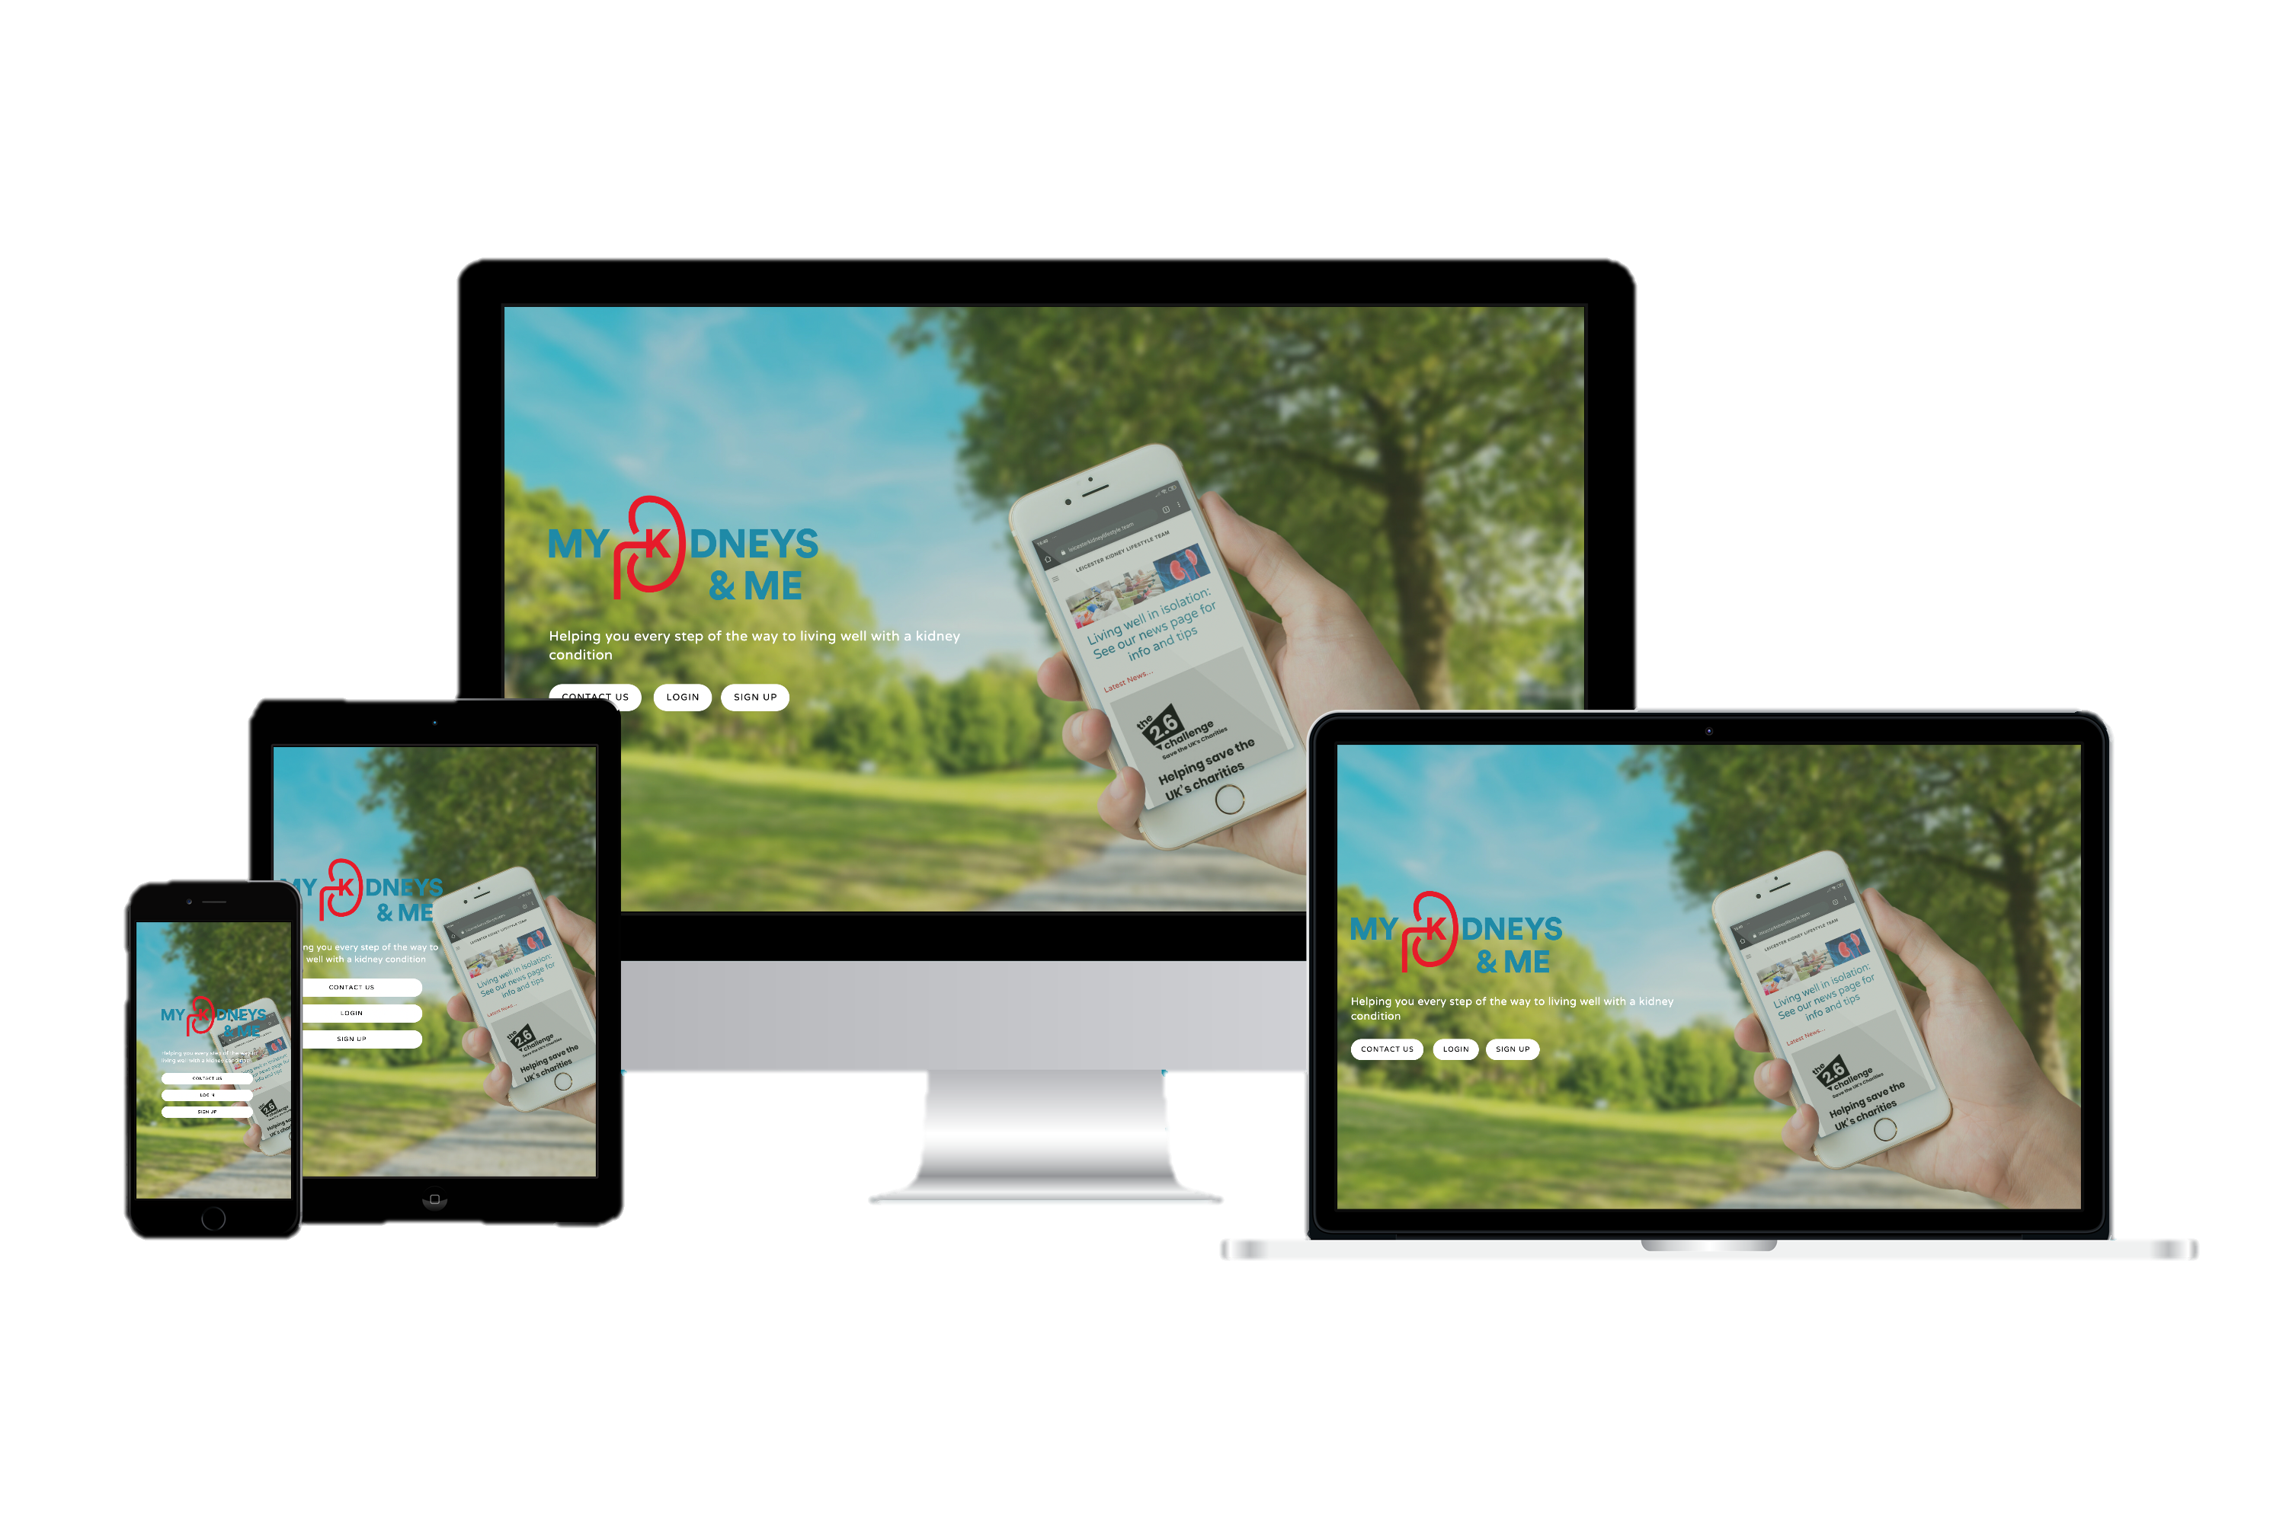




An interactive program designed to support people with kidney disease to better self-manage
Educational sessions providing information
about the kidneys, CKD,
its diagnosis, treatment and
different self-management techniques
Health trackers to allow monitoring of kidney-related symptoms, blood pressure, diet, physical activity and exercise
‘How to’ action sessions providing instructions to put learning into action
Goal setting to track health-related SMART goals
Ask health-related questions to healthcare professionals and chat to other users

Slide 37
Educational sessions

Slide 38
‘How to’ sessions
(knowledge to action)

Slide 39
Symptom & Health trackers

Slide 40
Activity trackers

Slide 41
Decision support tools

Slide 42
Chat forums
Ask the expert
Peer-peer

Slide 43
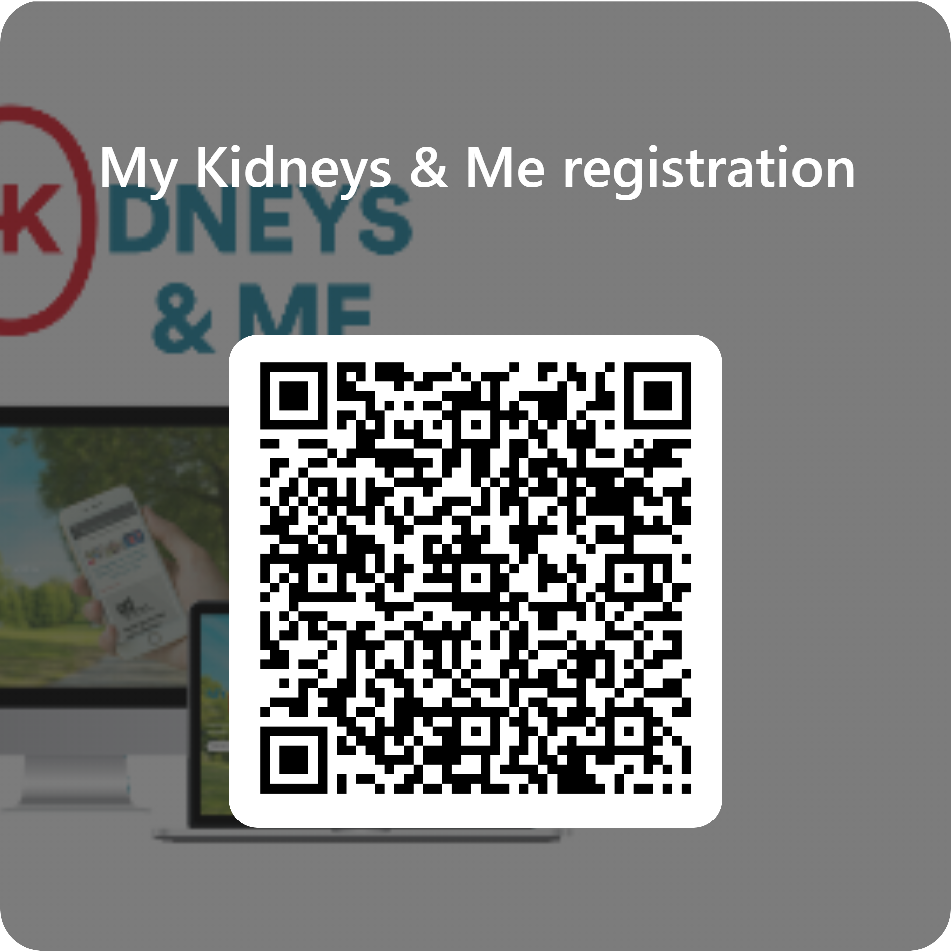
Step 1: Click on the camera app on your smartphone
Step 2: You do not need to take a photo – hold the phone steady and make sure the entire square of the QR code is visible on your screen
Step 3: After a second or two, a link or message should pop up on the screen
Step 4: Tap the message to open the form
*if the code is too far or too close, move the phone slowly until the QR appears clearly*
QR code

Slide 44
Any questions
mykidneys@me@leicester.ac.uk

